Slide 1
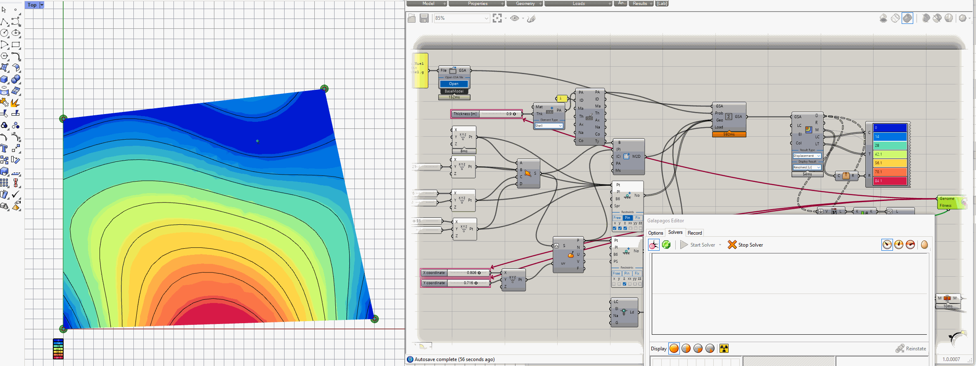

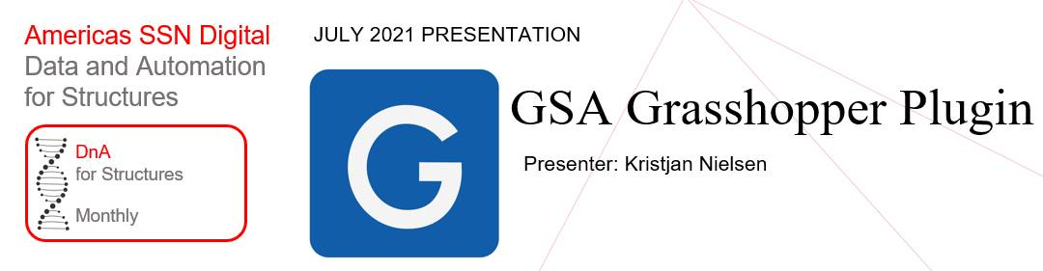
























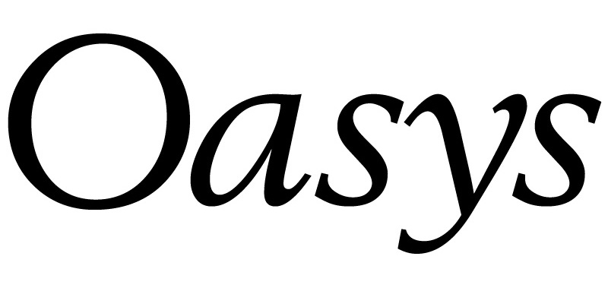

GSA Grasshopper Plugin
Dim
Annotation text
1
Highlight something
2
Highlight something
Americas SSN Digital
28th July 2021
Kristjan Nielsen
Notes:
I’m Kristjan
Based in Berlin
GSA-Grasshopper; Development is funded from Oasys
Oasys approved software for linking Grasshopper and GSA

Slide 2

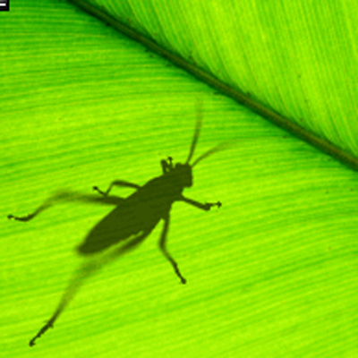










GsaAPI in Grasshopper
Notes:
Rhino: free form geometry engine
GH: visual programming
GSA-Grasshopper exposes the inside of GSA through the GsaAPI

Slide 3
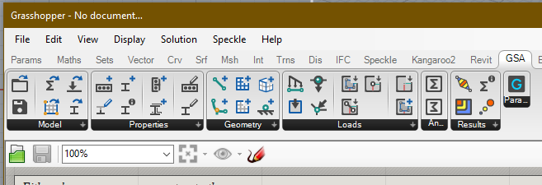





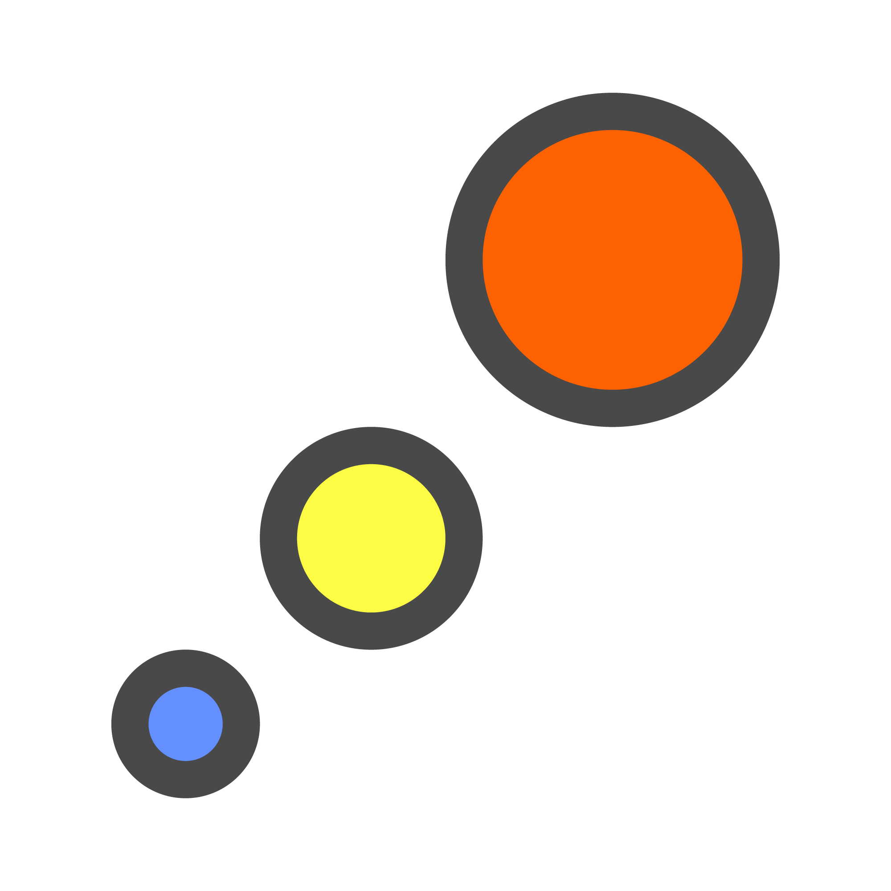


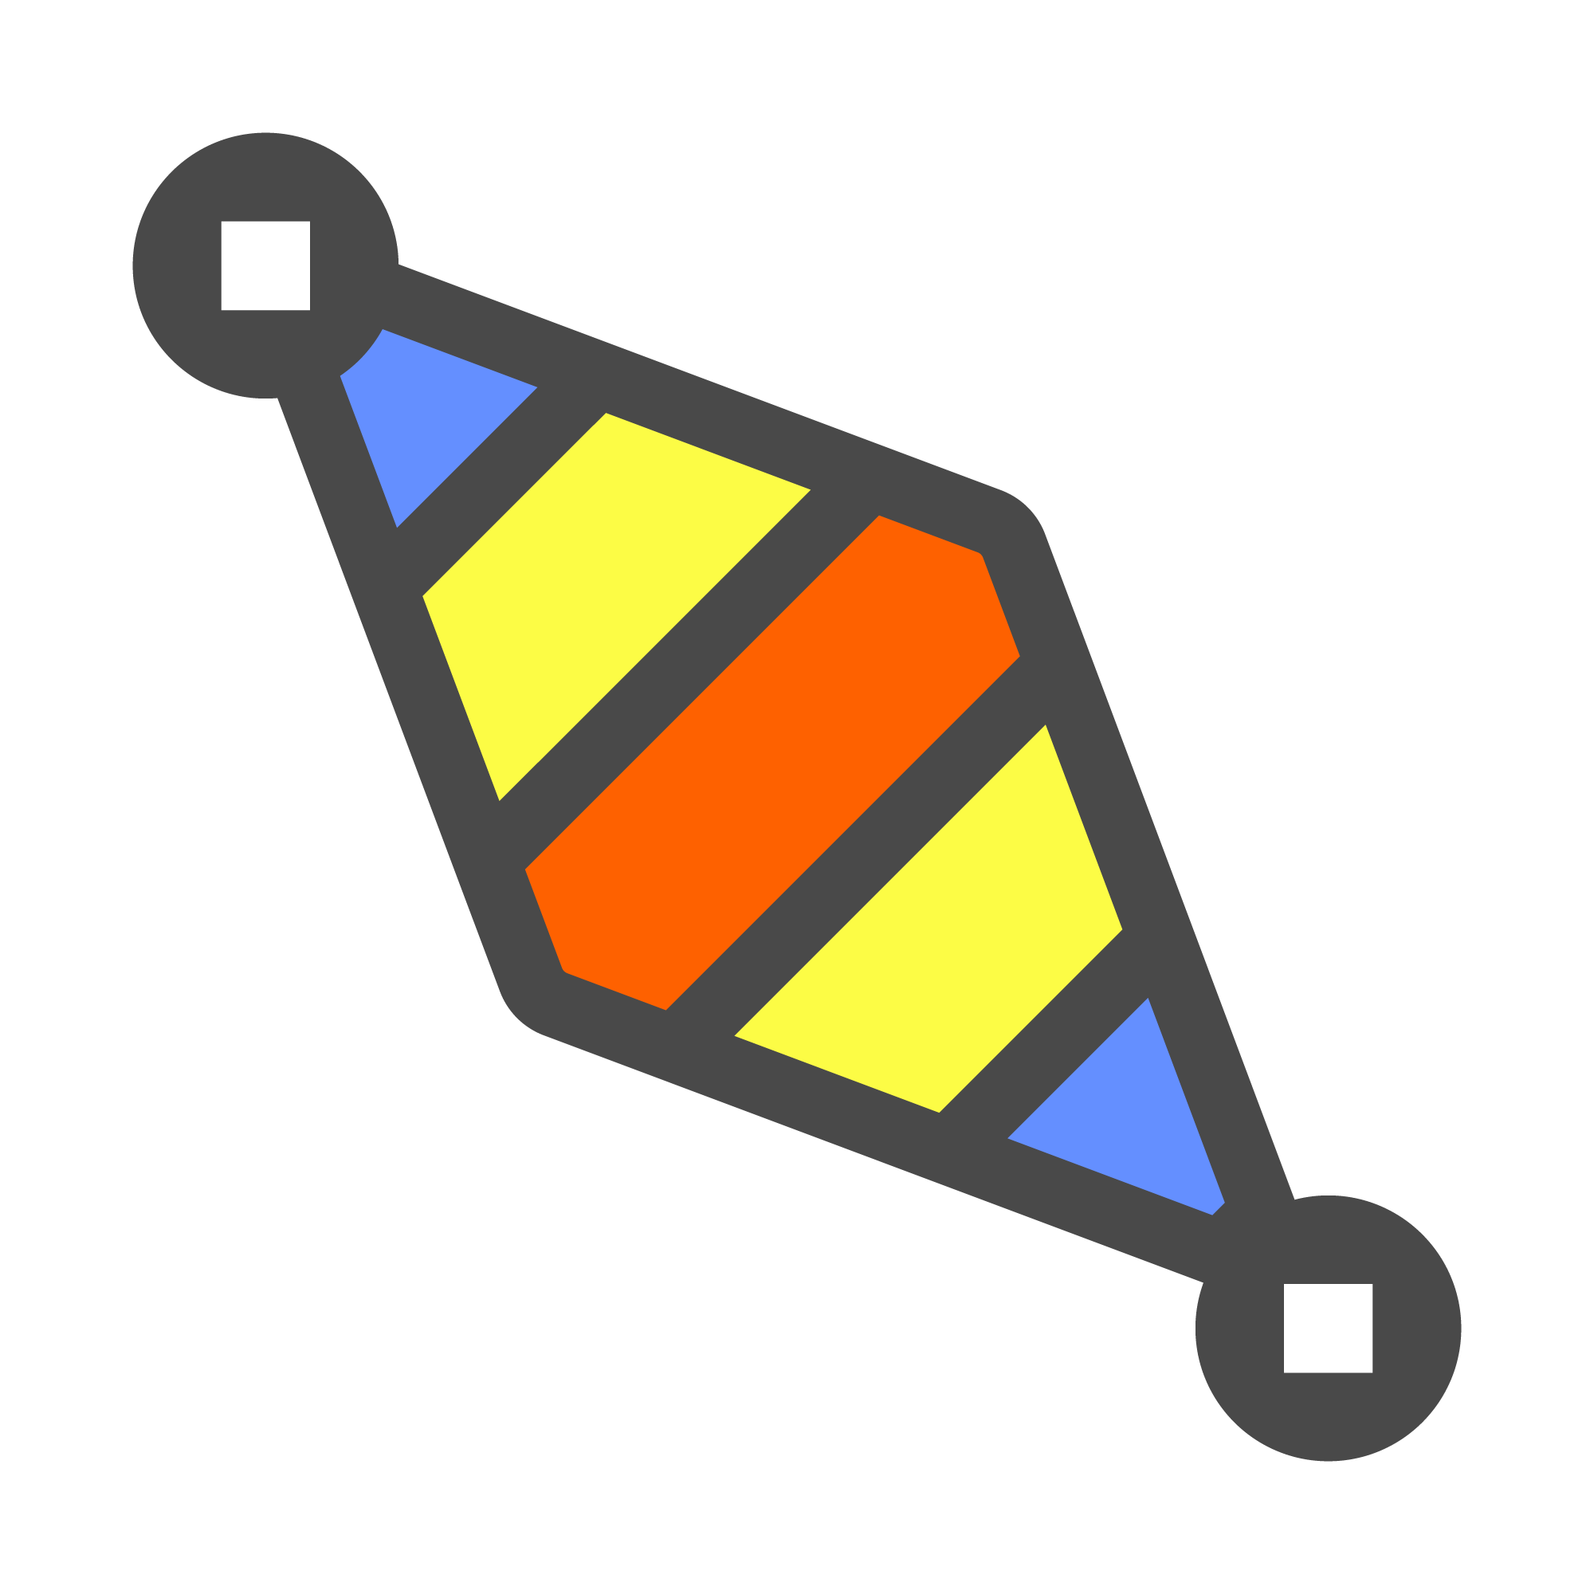



Model
GSA Model
GSA Model
Open Model
Save Model
Properties
Section
Prop2D
Offset
Spring
Bool6
Geometry
Node
Element1D
Element2D
Member1D
Member2D
Member3D
Loads
Load
GridPlnSrf
Node Res.
1D Results
2D Results
Analyse
Results
Overview Plugin workflow
Notes:
Model: Existing model and tools for saving, units, etc
Prop: materials, cross sections
Geometry: nodes, element/members
Loads
Analyse
Results

Slide 4
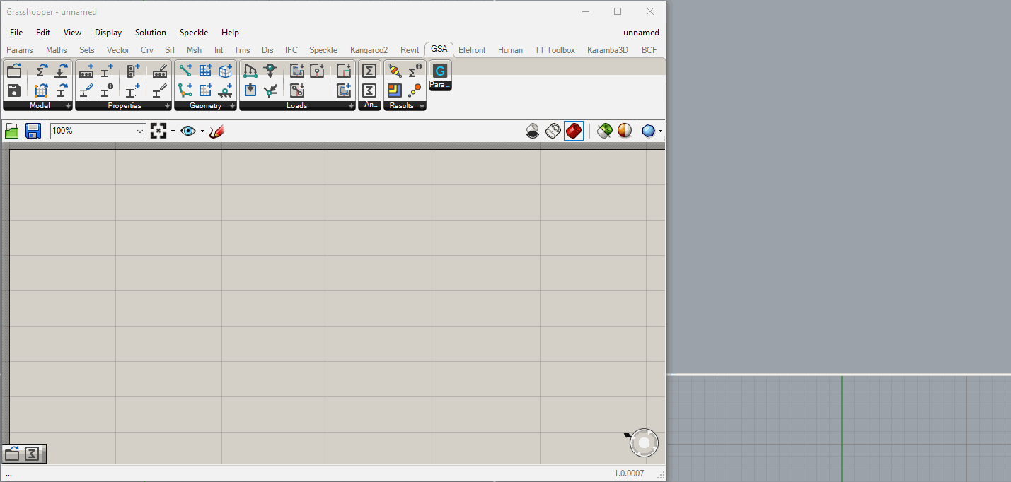
Open Model & Get Geometry
Notes:
Many workflows possible
Depending on what you want
Open existing model
Get the geometry
New set of GSA Grasshopper Parameter

Slide 5
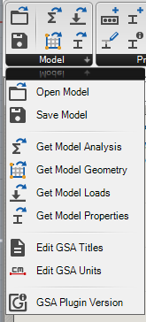
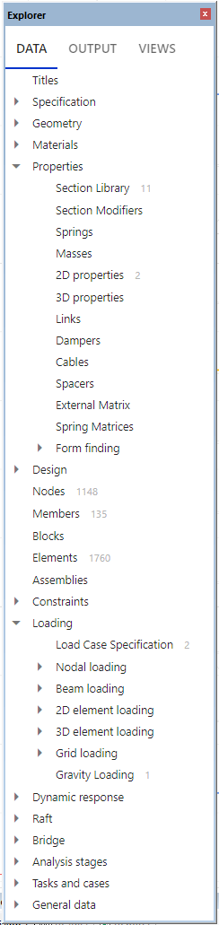
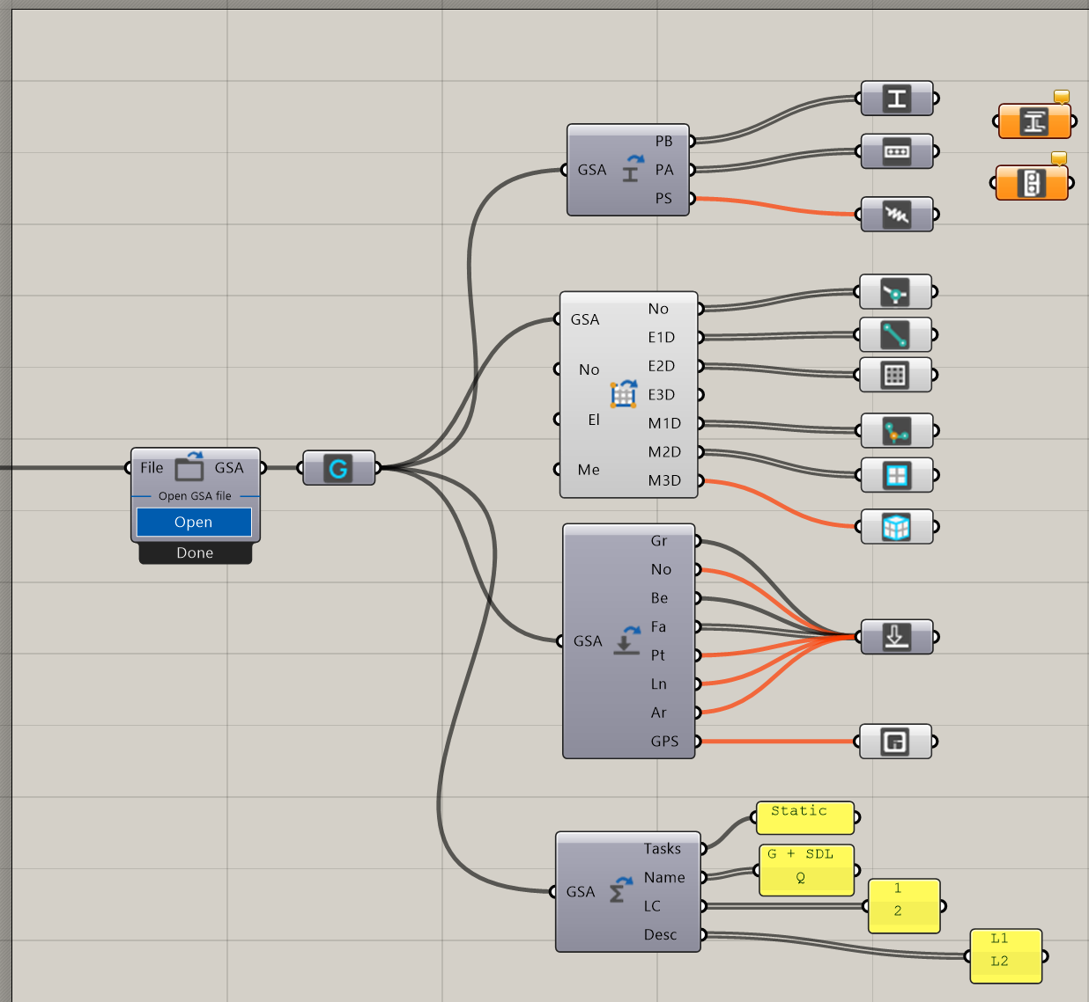
GSA Grasshopper Parameters – GSA Reference
Notes:
Quick overview
This is how each parameter links to GSA

Slide 6

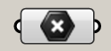

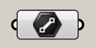

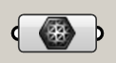

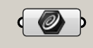

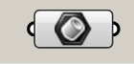

0D
Node
Point3D
(x, y, z)
1D
Element1D
Line
(x₁, y₁, z₁, x₂, y₂, z₂)
2D
Element2D
Mesh
(Verticies, FaceList)
1D
Member1D
PolyCurve (Arc or Polyline)
(TopologyList)
Nurbs crv auto-converted to Arc or Polyline
2D
BRep auto-converted to planar
Nurbs edges and incl. Crvs auto-converted to Arcs and Lines
Inclusion Pts and Crvs auto-projected onto plane
Member2D
Planar BRep (Edges, inc.Lines, inc.Pts)
3D
Member3D
Solid (Closed Mesh) (Verticies, FaceList)
BRep auo-capped if not closed
BRep auto-converted to mesh
Rhino/GH Geometry correlation with GSA Geometry
Notes:
And this is how each GSA Parameter
Link to Rhino/GH geometry types
Lots of automatic conversions in the background

Slide 7
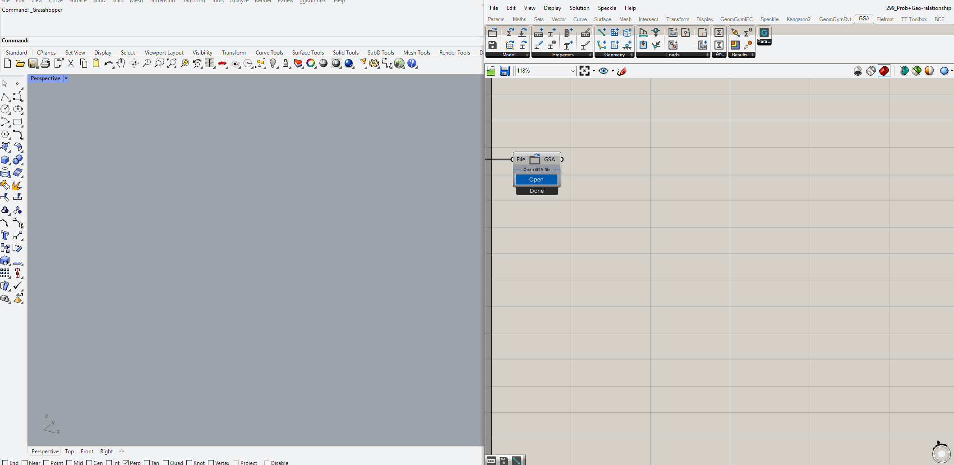
On-the-fly conversions from existing GSA Model
Notes:
Model is just a model (no visualisation),
Can open and save etc
Take out all geometry
Select element 1d
Select nodes

Slide 8
Properties

Slide 9
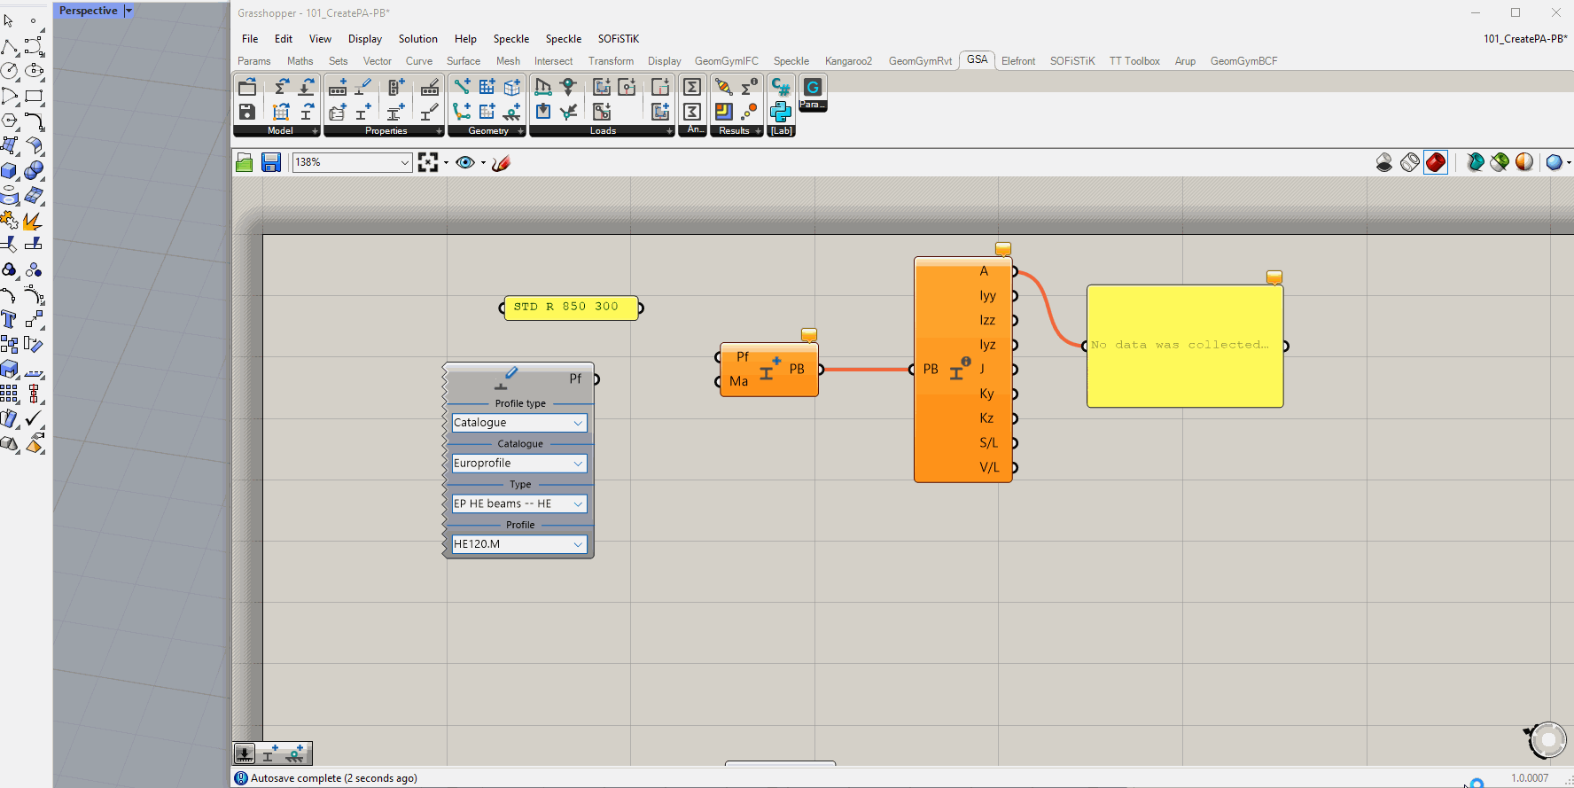
Create Section and Property 2D

Slide 10
Properties
Geometry
Element1D
1D
Section
Member1D
Element2D
Prop2D
2D
Member2D
Relationship Section/Prop2D to Elements/Members

Slide 11
Loads

Slide 12
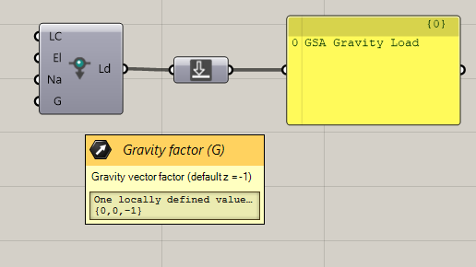

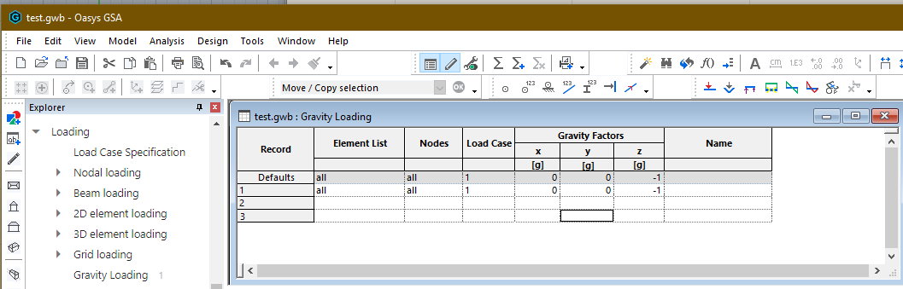
Typical Loads - Gravity

Slide 13
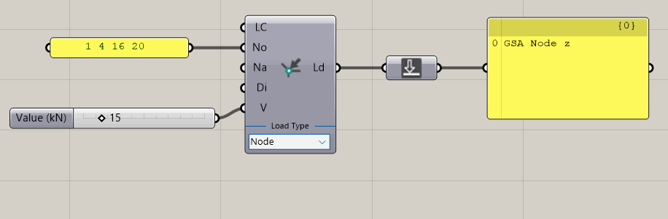
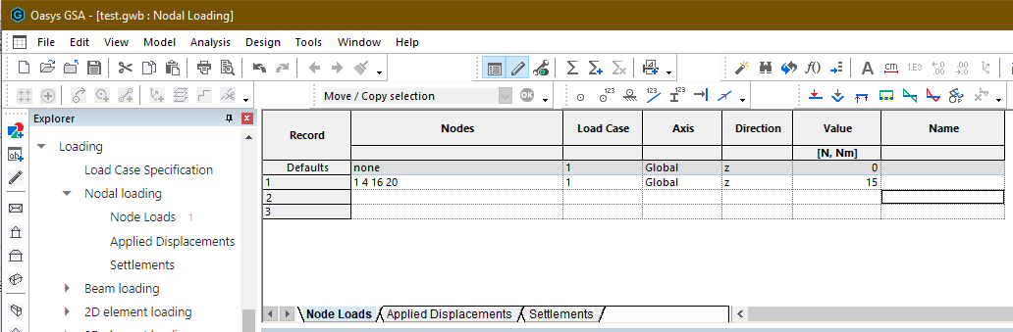
Typical Loads – Node Load

Slide 14
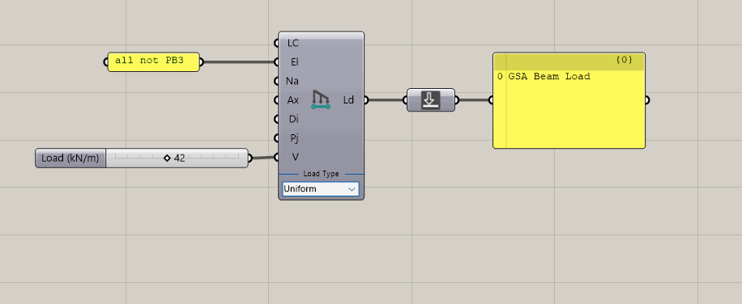
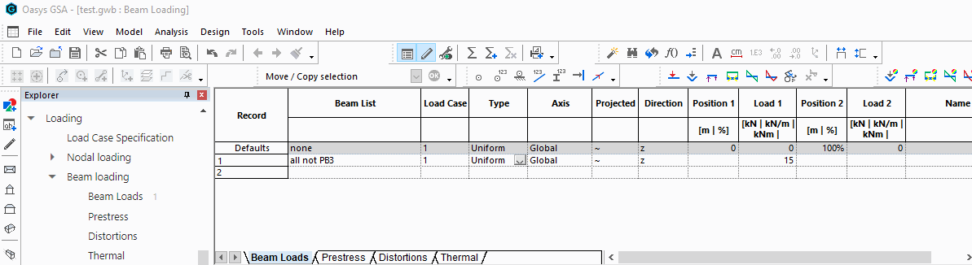
Dropdown UI to change Load Type
Typical Loads – Beam Load

Slide 15
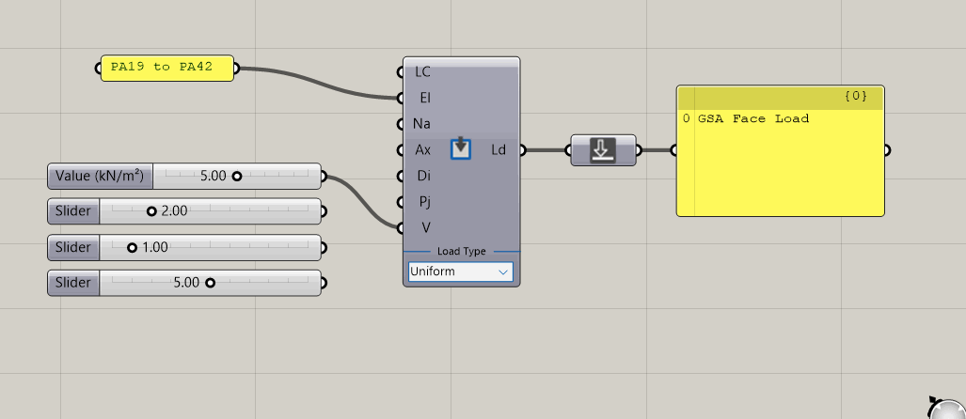
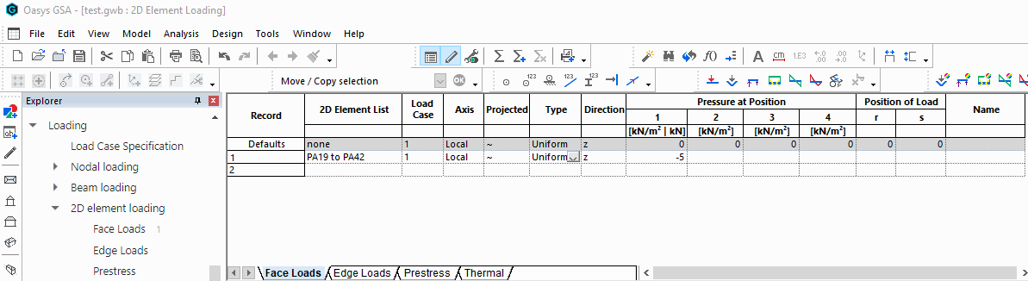
Dropdown UI to change Load Type
Typical Loads – Face Load

Slide 16
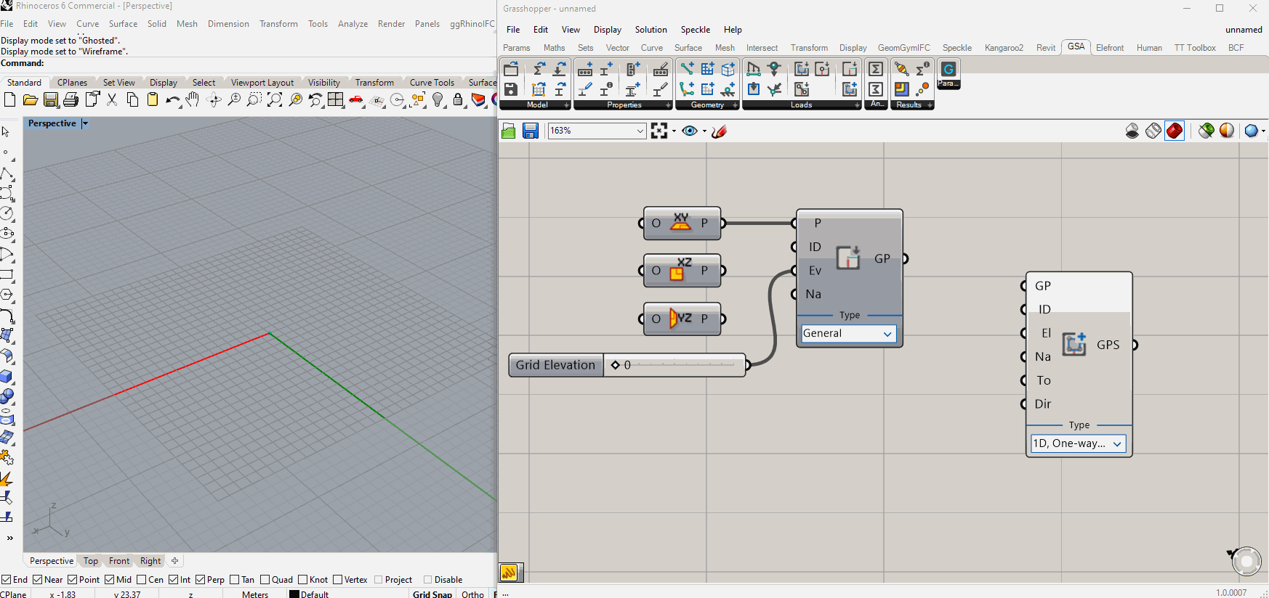
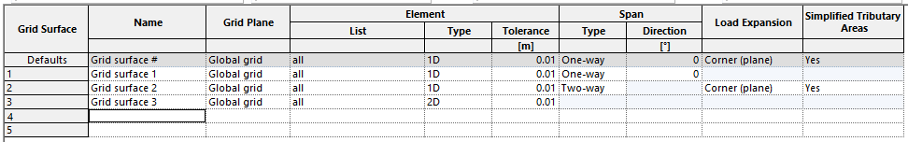
GridPlaneSurface Parameter – Grid Surface

Slide 17
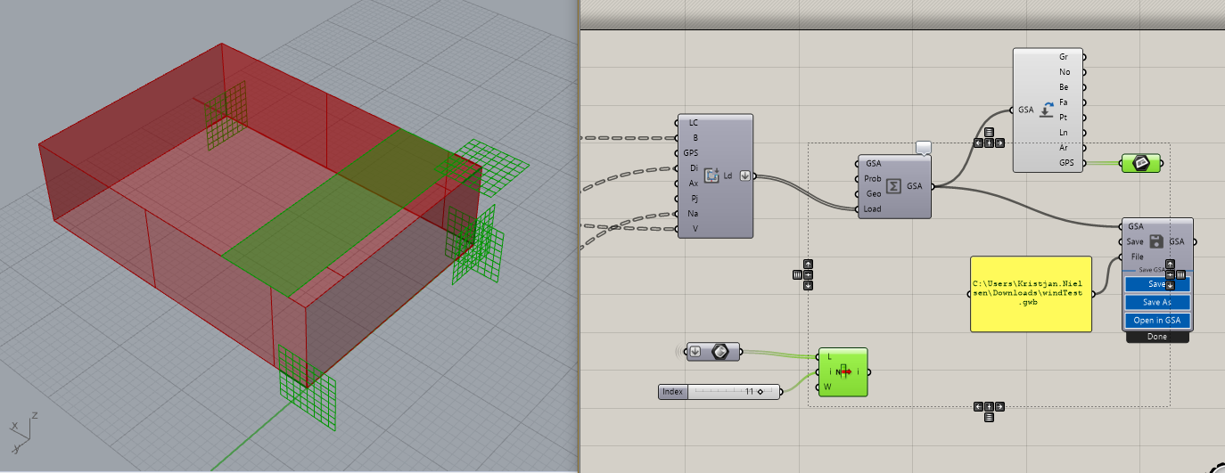
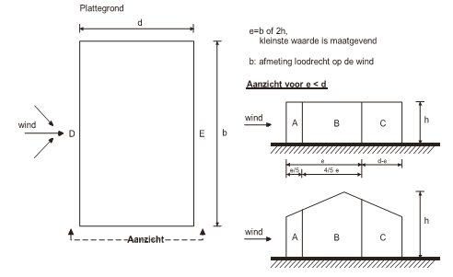
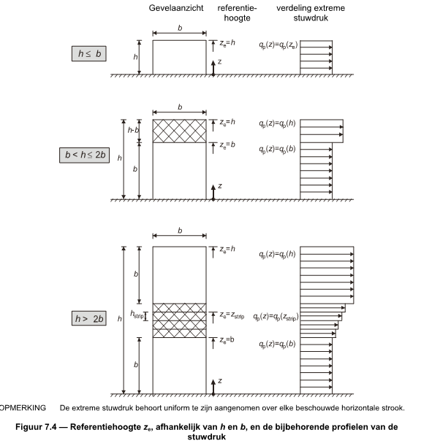
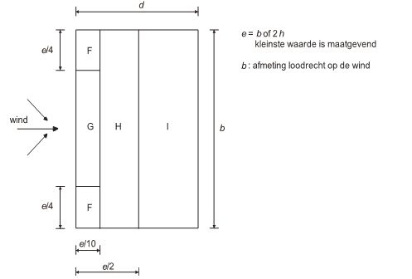
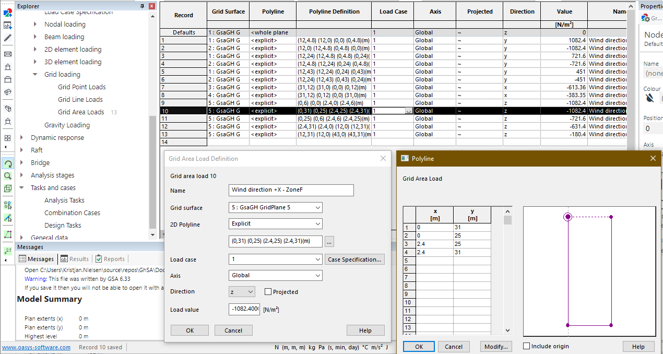
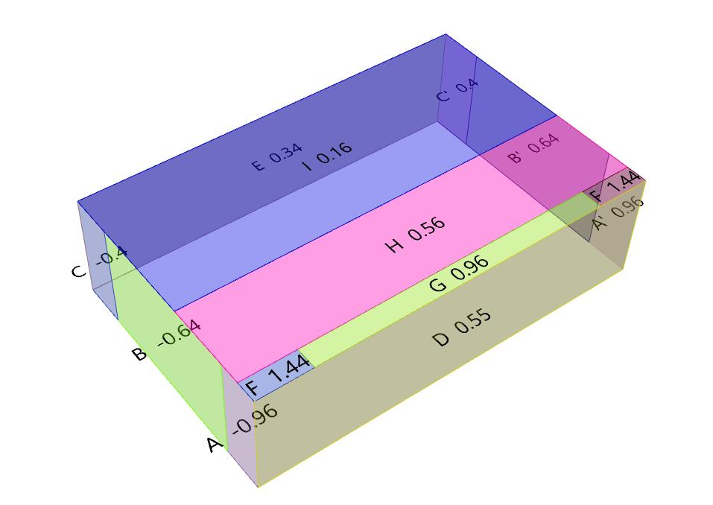
GridAreaLoad Wind Load Generator

Slide 18
Creating geometry
Remeshing

Slide 19
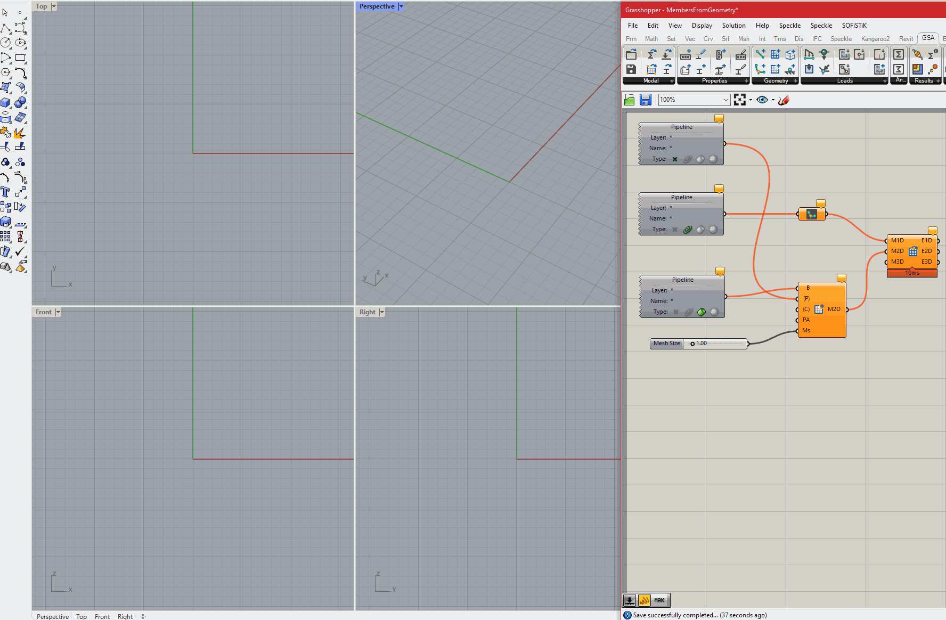
Remeshing example (Create Elements from Members)

Slide 20
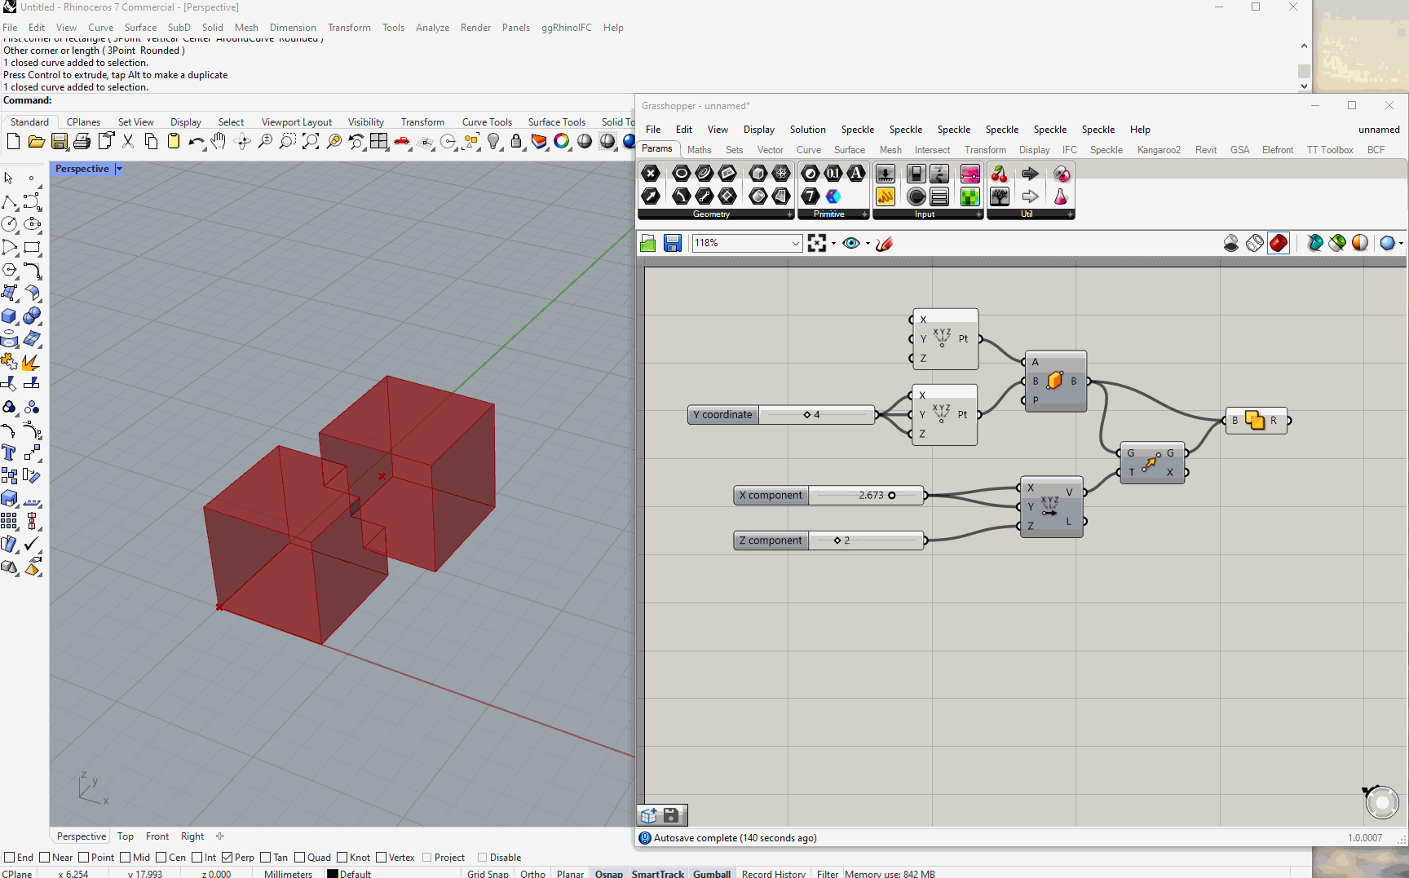
Create Member3D Example

Slide 21
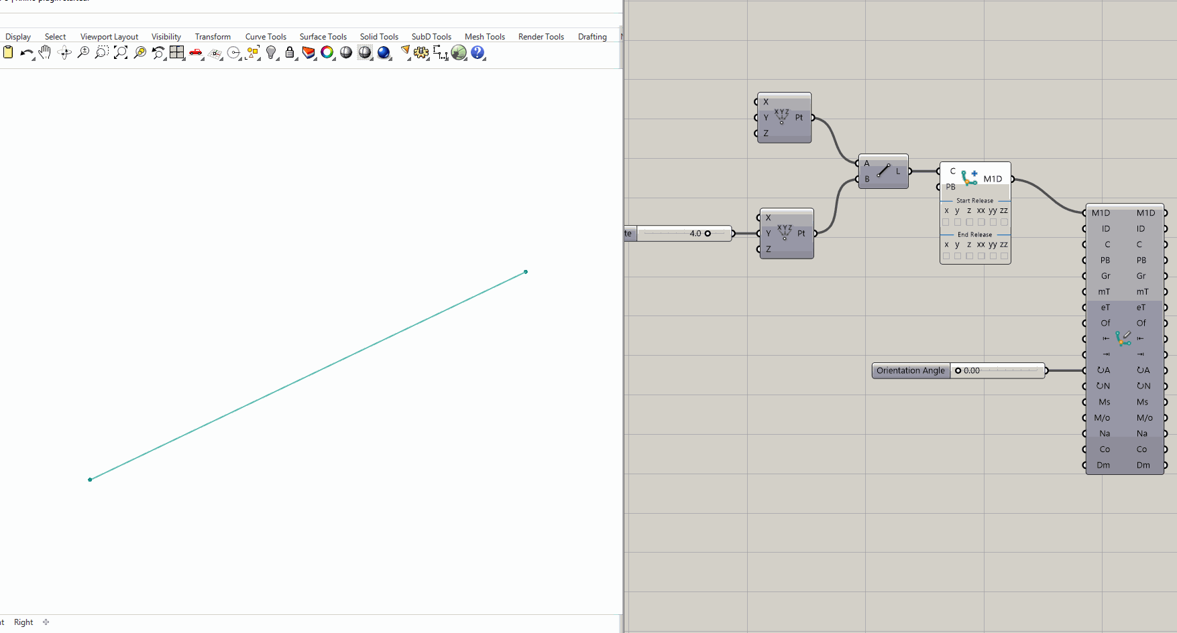
Visualisation

Slide 22
Assemble
Assemble parts into a GSA model

Slide 23
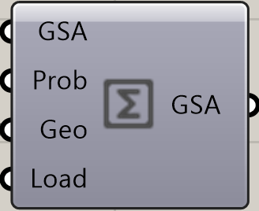
Model
GSA Model
GSA Model
Open Model
Save Model
Properties
Section
Prop2D
Offset
Spring
Bool6
Geometry
Node
Element1D
Element2D
Member1D
Member2D
Member3D
Loads
Load
GridPlnSrf
Node Res.
1D Results
2D Results
Analyse
Results
GSA Grasshopper Workflow

Slide 24
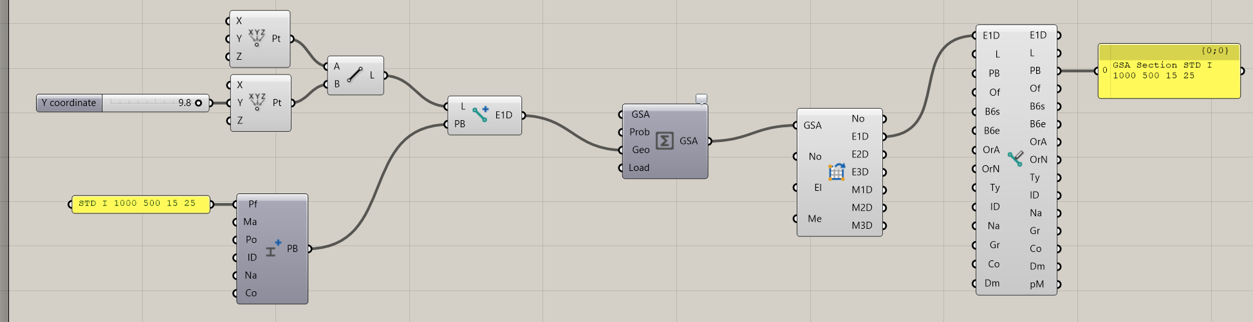
Create new Element1D from Line and input PB to attach this section to the Element1D object. The Element1D object will carry the Section with it around the GH script
2
3
1
Create new Section without ID (ID = 0). Section will be appended to end of existing Section Library
Assembling the model using Analysis Component can be done without inputting Section in “Prop”
Workflow Example 1

Slide 25
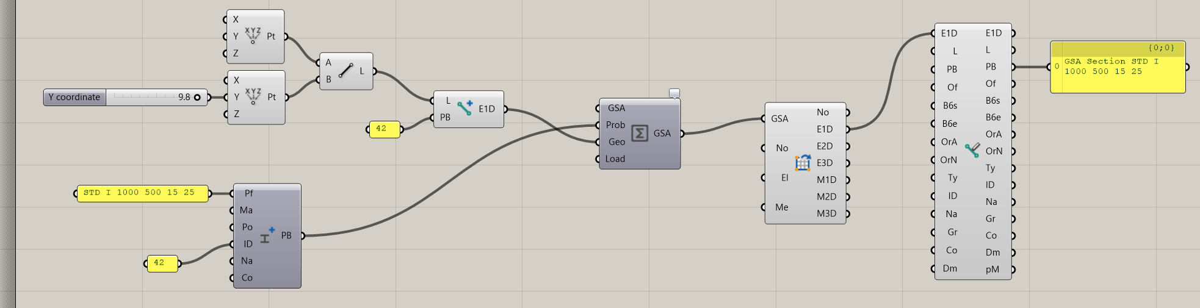
Create new Element1D from Line and input Integer (42 here) in PB-input to make reference to a Section number in the Section Library. Section may already exist in a GSA model and does not need to be created in Grasshopper
2
3
1
Create new Section with unique ID (ID = 42 here). Section will be set (and overwrite existing Section) in Section Library
Assembling the model using Analysis Component should be done with both Prop and Geo inputs, unless Section already exist in an existing GSA model
Workflow Example 2

Slide 26
Analysis
Results

Slide 27
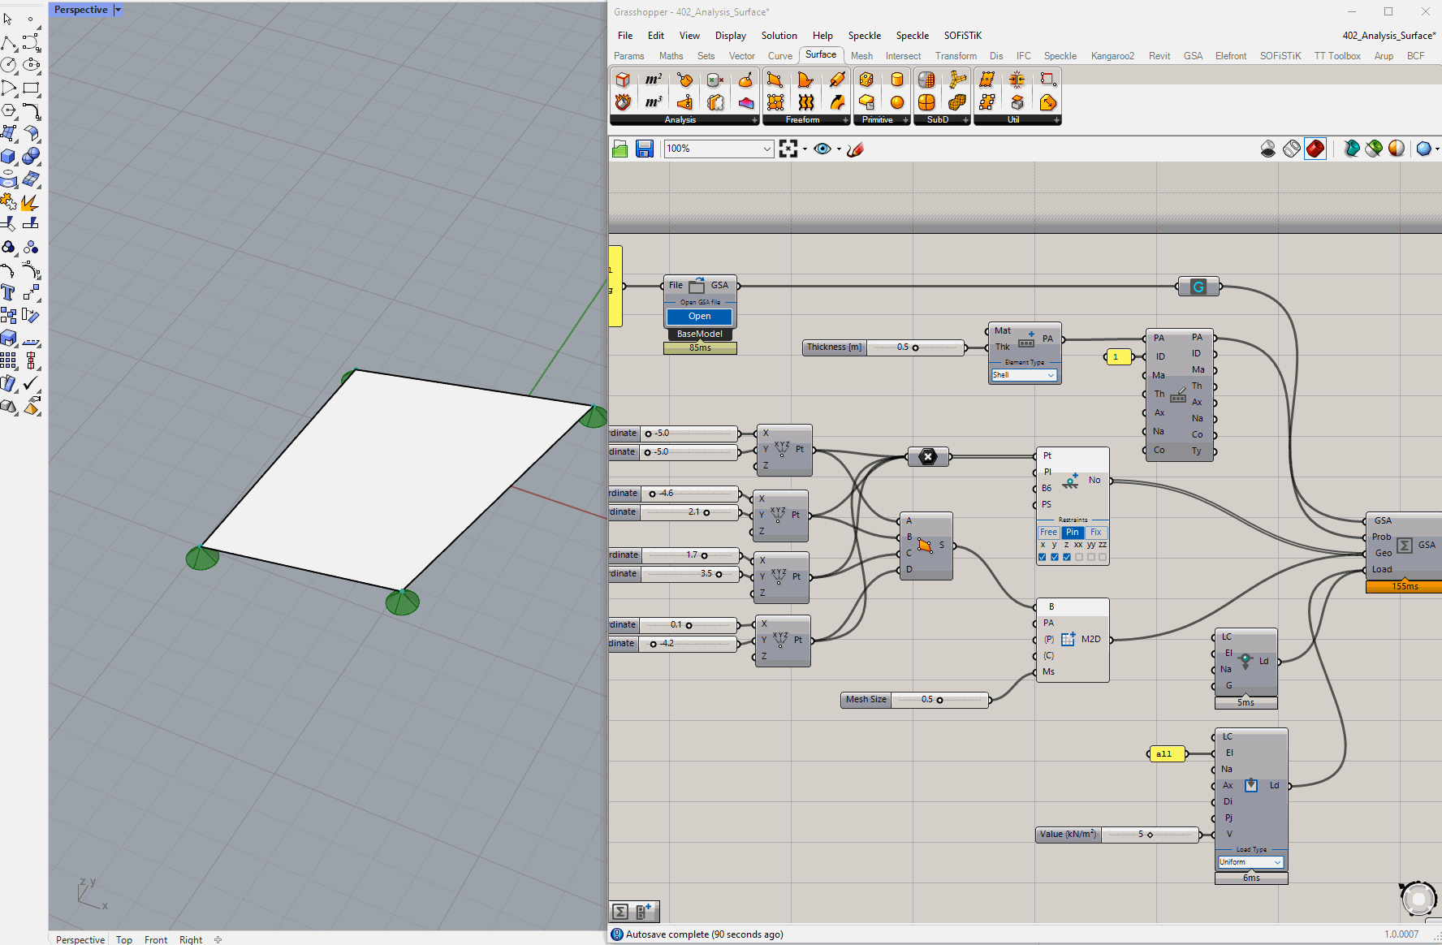
Analysis and results

Slide 28
Optimisation

Slide 29

Installing Plugin
Using Rhino Package Manager

Slide 30
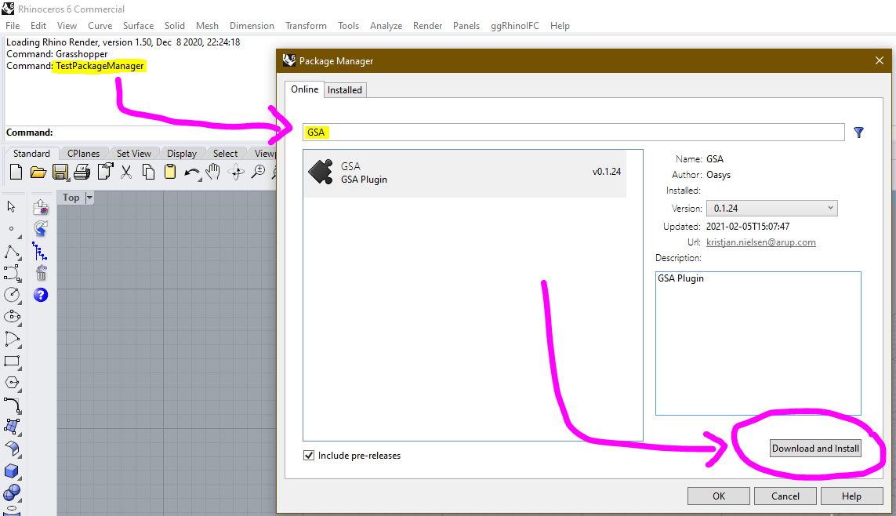

1
2
Rhino6 Command:
TestPackageManager
3
Installing GSA-Grasshopper

Slide 31
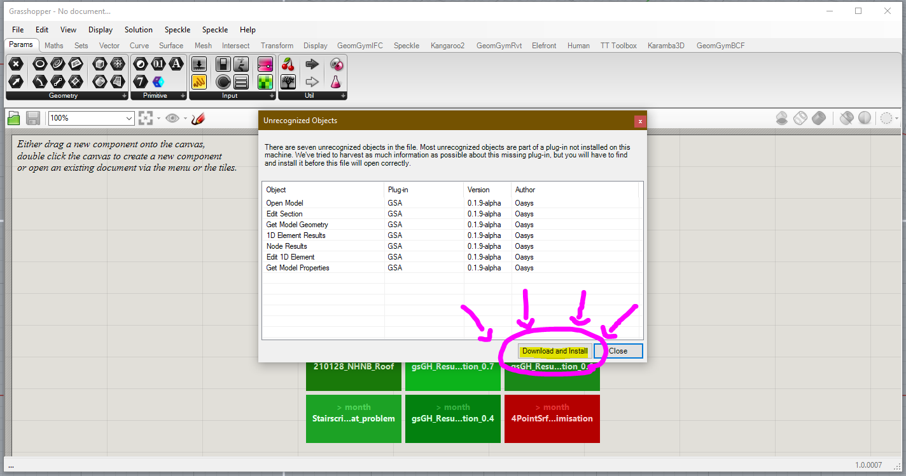
Installing GSA-Grasshopper

Slide 32
Rhino.Inside.Revit
Using the plugin in Revit

Slide 33
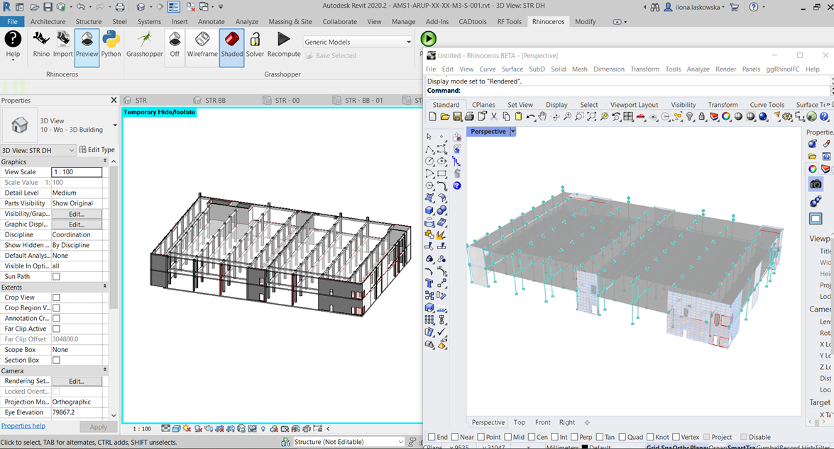
Rhino.Inside.Revit

Slide 34
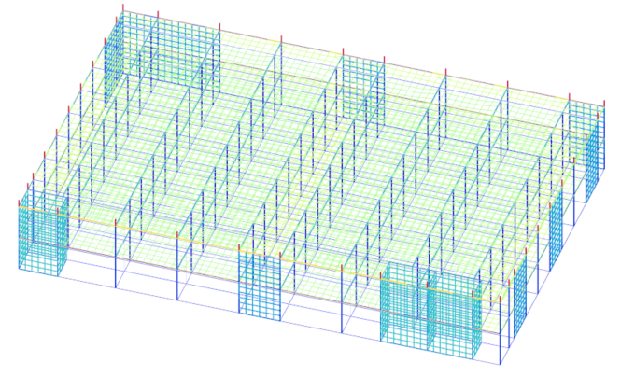
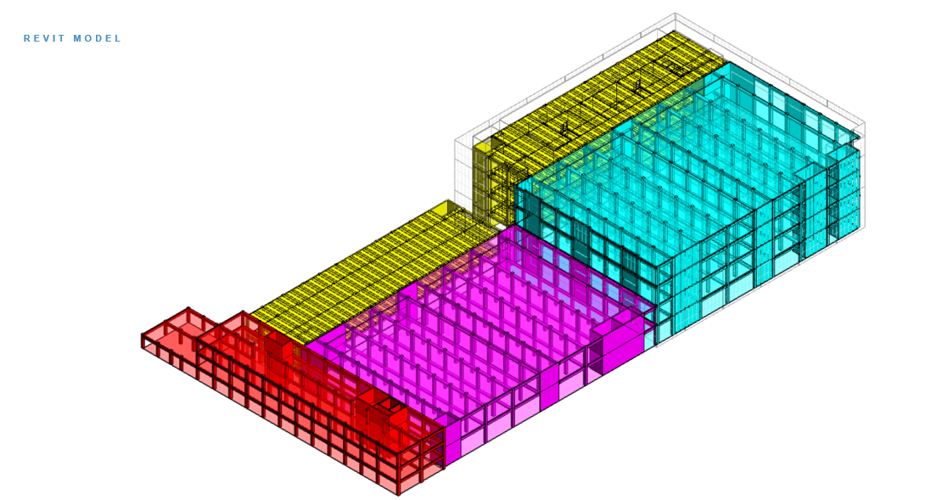
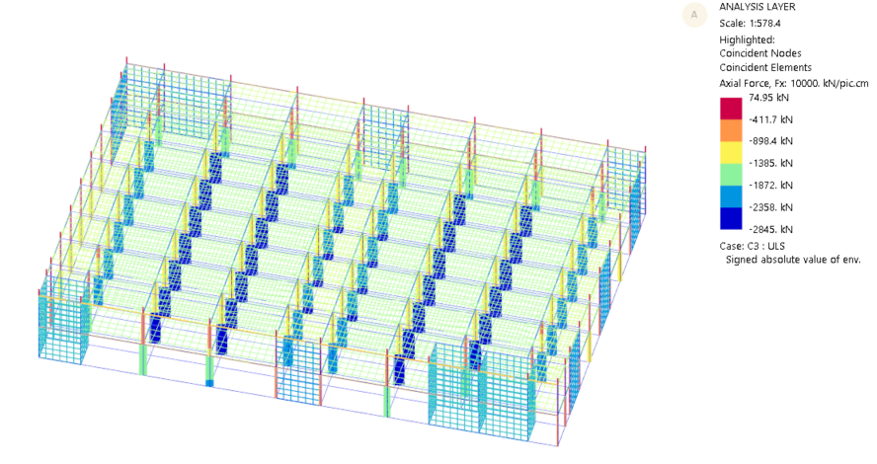
Rhino.Inside.Revit

Slide 35
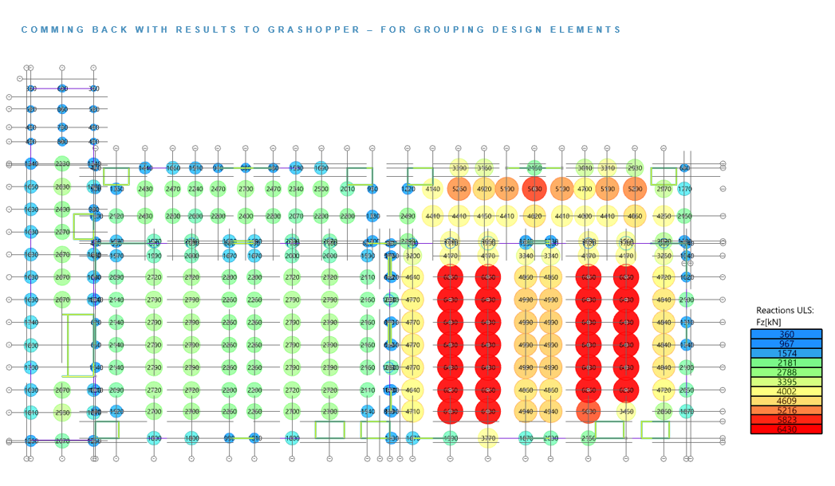
Rhino.Inside.Revit

Slide 36
Wrap up

Slide 37
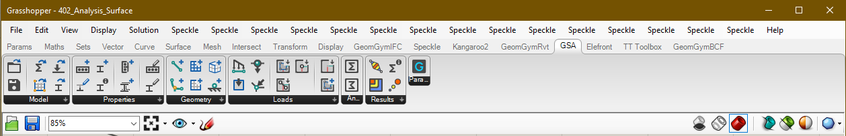
Known bugs and limitations
Current state of the plugin is Beta – there will likely be bugs and the GsaAPI is not complete
Materials cannot be created only referenced – GSA-Grasshopper material parameter to be developed
Analysis tasks cannot be created – GSA-Grasshopper analysis task parameter to be developed
Spring parameter not working at all (placeholder in plugin for now)
Releases cannot be set in neither Element1D or Member1D
Not all GSA’s settings for Elements and Members covered in GsaAPI
Meshing of large models becomes really slow
Result components are WIP (you should, as with everything, check your results)
No results for Load Combinations are available
Units cannot be change (placeholder in plugin for now). Use [kN-m] for now (sorry US!)
Titles cannot be set (placeholder in plugin for now)
No graphical visualisation of cross-sections
Conflict with referenced dll when running analysis and having older versions of Karamba3D plugin installed
Speckle interoperability to be implemented
AdSec components currently under development

Slide 38
AdSecAPI released
GsaAPI released
Speckle2.0 integration
TDA integration
Now
Future
GsaGrasshopper 1.0 released
AdSecGrasshopper 1.0 released
Structural API
Up next

Slide 39
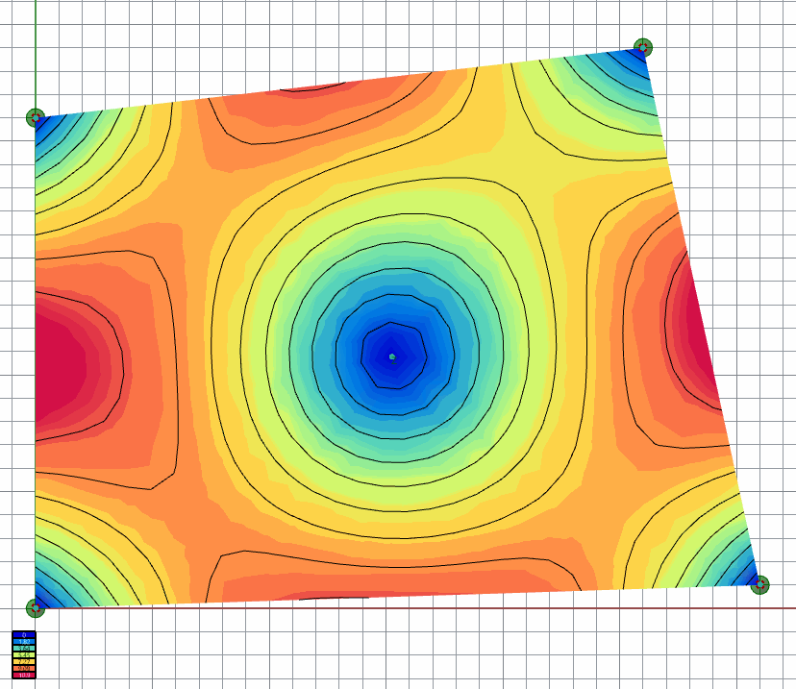
Thank you

